Slide 1
Guided Capstone Executive Summary
Jeffrey Jex
Unit 6.7, Big Mountain resort case study

Slide 2
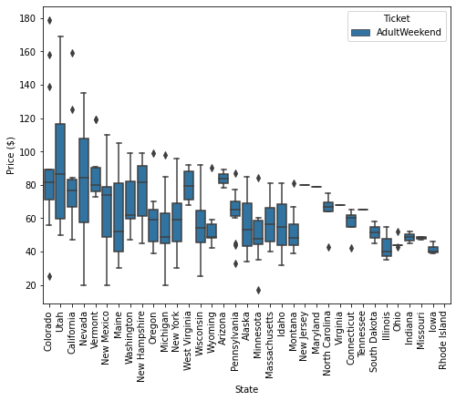

Pricing Problem
Is Big Mountain resort appropriately priced for its market segment?
Connection between facilities and pricing is unclear
Potentially missed revenue from undercharging
Insight on facility value allows:
Alignment of park priorities with customer’s
Invest in most significant facilities
Big Mountain
Notes:
This Photo by Unknown Author is licensed under CC BY-ND

Slide 3
Recommendations
Raise the ticket price $4 - $14
Current price is $4 below the models expected price range + error.
Increase vertical drop and add chair
This investment pays for itself with a warranted $1.99 raise to ticket price.
Consider closing up to 5 runs
Contingent on if revenue loss of ~$1,200,000/year is less than the operational savings of dropping runs.
Recommended price
$95 - $85
Model price: $95.85
Current price: $81.00

Slide 4
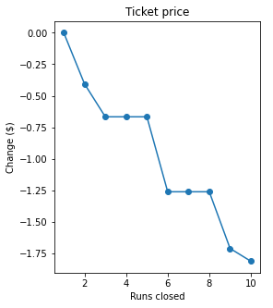
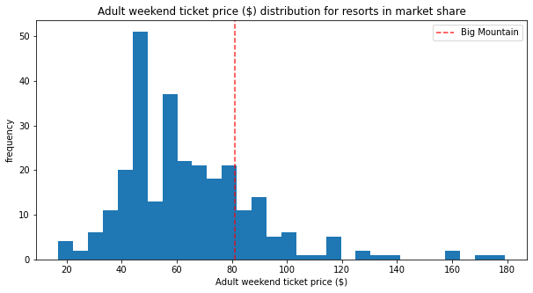
Modeling Results and Analysis
Scenario 1
This study considered 5 scenarios
0. No change to park, what should current price be.
Permanently closing up to 10 runs.*
The output is a stair-step function, indicating closing up to 5 runs should have the least effect on ticket price.
Increase the vertical drop, add one chair lift *
This scenario increases support for ticket price by $1.99, give an additional revenue of $3,474,638
Additional chair lift adds $1,540,000 operating cost, easily be handled by the increased revenue.
Same as number 2, but adding 2 acres of snow making cover *
Extra snow cover has no effect on ticket price
Increase the longest run by 0.2 mile to boast 3.5 miles length, requiring an additional snow making coverage of 4 acres
No effect on ticket price
Big Mountain
81st percentile of price
*This is assuming 350,000 visitors a year, on average buying 5 tickets each.

Slide 5

Summary and Conclustion
Key features have the most effect on the model (observed in linear regression or final random forest)
Big Mountain should prioritize quality and improvements to these facilities more than others.
Vertical drop
Snow Making (total area)
Total chairs
Number of Fast Quads
Number of Runs
Longest Run (length)
Number of trams
Skiable Terrain (area)
Notes:
This Photo by Unknown Author is licensed under CC BY-NC

